Slide 1
Automation workflows at Data Lab / Modeling of AGN torus properties with ML techniques
Keenan Fiedler

Slide 2
Automation workflows at Data Lab
Technical Project

Slide 3
Github Actions allow for automation of tasks
Github is a service for storage, collaboration, and creation of code and files
Code can run on a github repository after various git actions are taken
Pull requests - requests to add a new change to the main repository, affecting everyone
Uses yaml and bash scripting
Yaml is a programming language used for configuration files and messaging. Github uses it for running steps and setting up environments in actions.
Useful for error checking, unit testing, and many more functions
Runs on a virtual machine on Github servers
Many open-source Github Actions have been created by other users

Slide 4
Automating conversion of notebooks to HTML
Data Lab has a Github repository for science example Jupyter Notebooks
Each notebook has an HTML copy for easier preview without loading a Jupyter environment
Problem: HTML generated by hand after changes finalized
nbconvert package allows conversion of Jupyter Notebooks
Open-source github actions can get all changed files in a PR
Pull Request
Get changed notebook files
Convert to HTML
Add HTML files to the PR
PR ready for review
Merge if approved

Slide 5
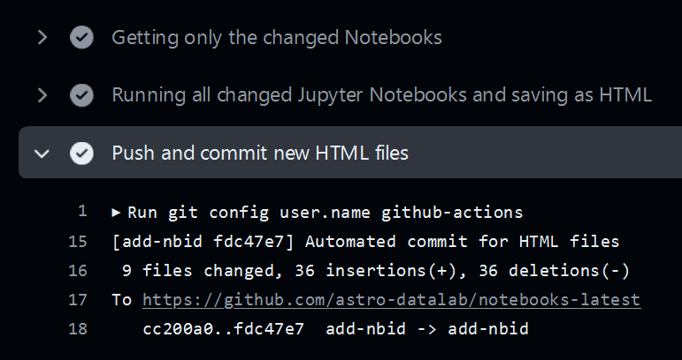
HTML conversion is fully automated for PRs
Successfully working and in production for the past few months
Takes only 1-2 minutes to run on about 10 notebook files
Massive time save and ease of adding new notebooks by contributors

Slide 6
Modeling of AGN torus properties with ML techniques
Science Project

Slide 7
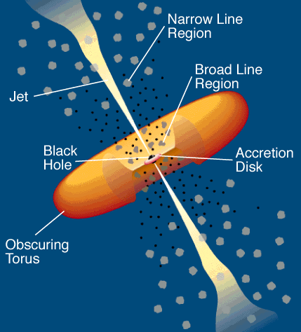
AGN should have a torus of dust in clumps
AGN don’t have a stellar (black-body) spectrum
They show an IR peak → dust can do that
They come in two flavors: type-2 with narrow emission lines & type-1 with both broad and narrow lines → orientation effect
Broad lines observed in type-2s as well, but in polarized light → scattered towards us
Smooth dusty torus can’t sustain the vertical height required to explain type-1/type2 number statistics → dust in clumps can
Line-of-sight variation of obscuring gas column observed in X-rays → variations consistent with orbiting clumps
AGN unification (from Urry & Padovani 1995)
Notes:
Normal gal - light from stars - black body
AGN - non stellar - broken power law with stellar on top Type 2 has broad as well -> scattering -> torus
longevity of torus -> millions of packets -> doesn’t break down into disk

Slide 8
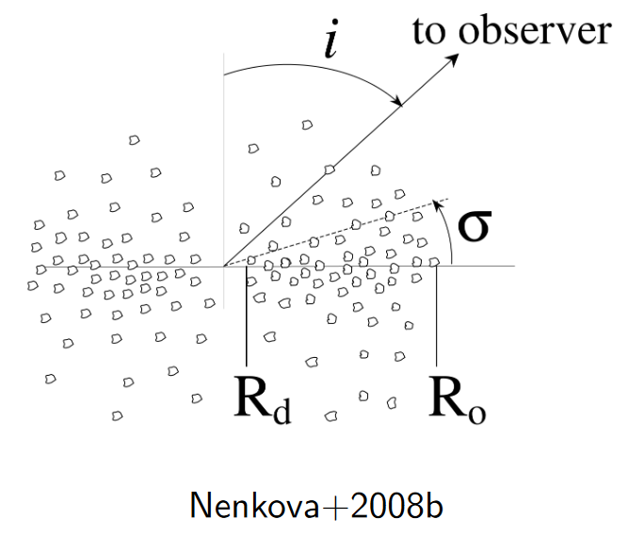
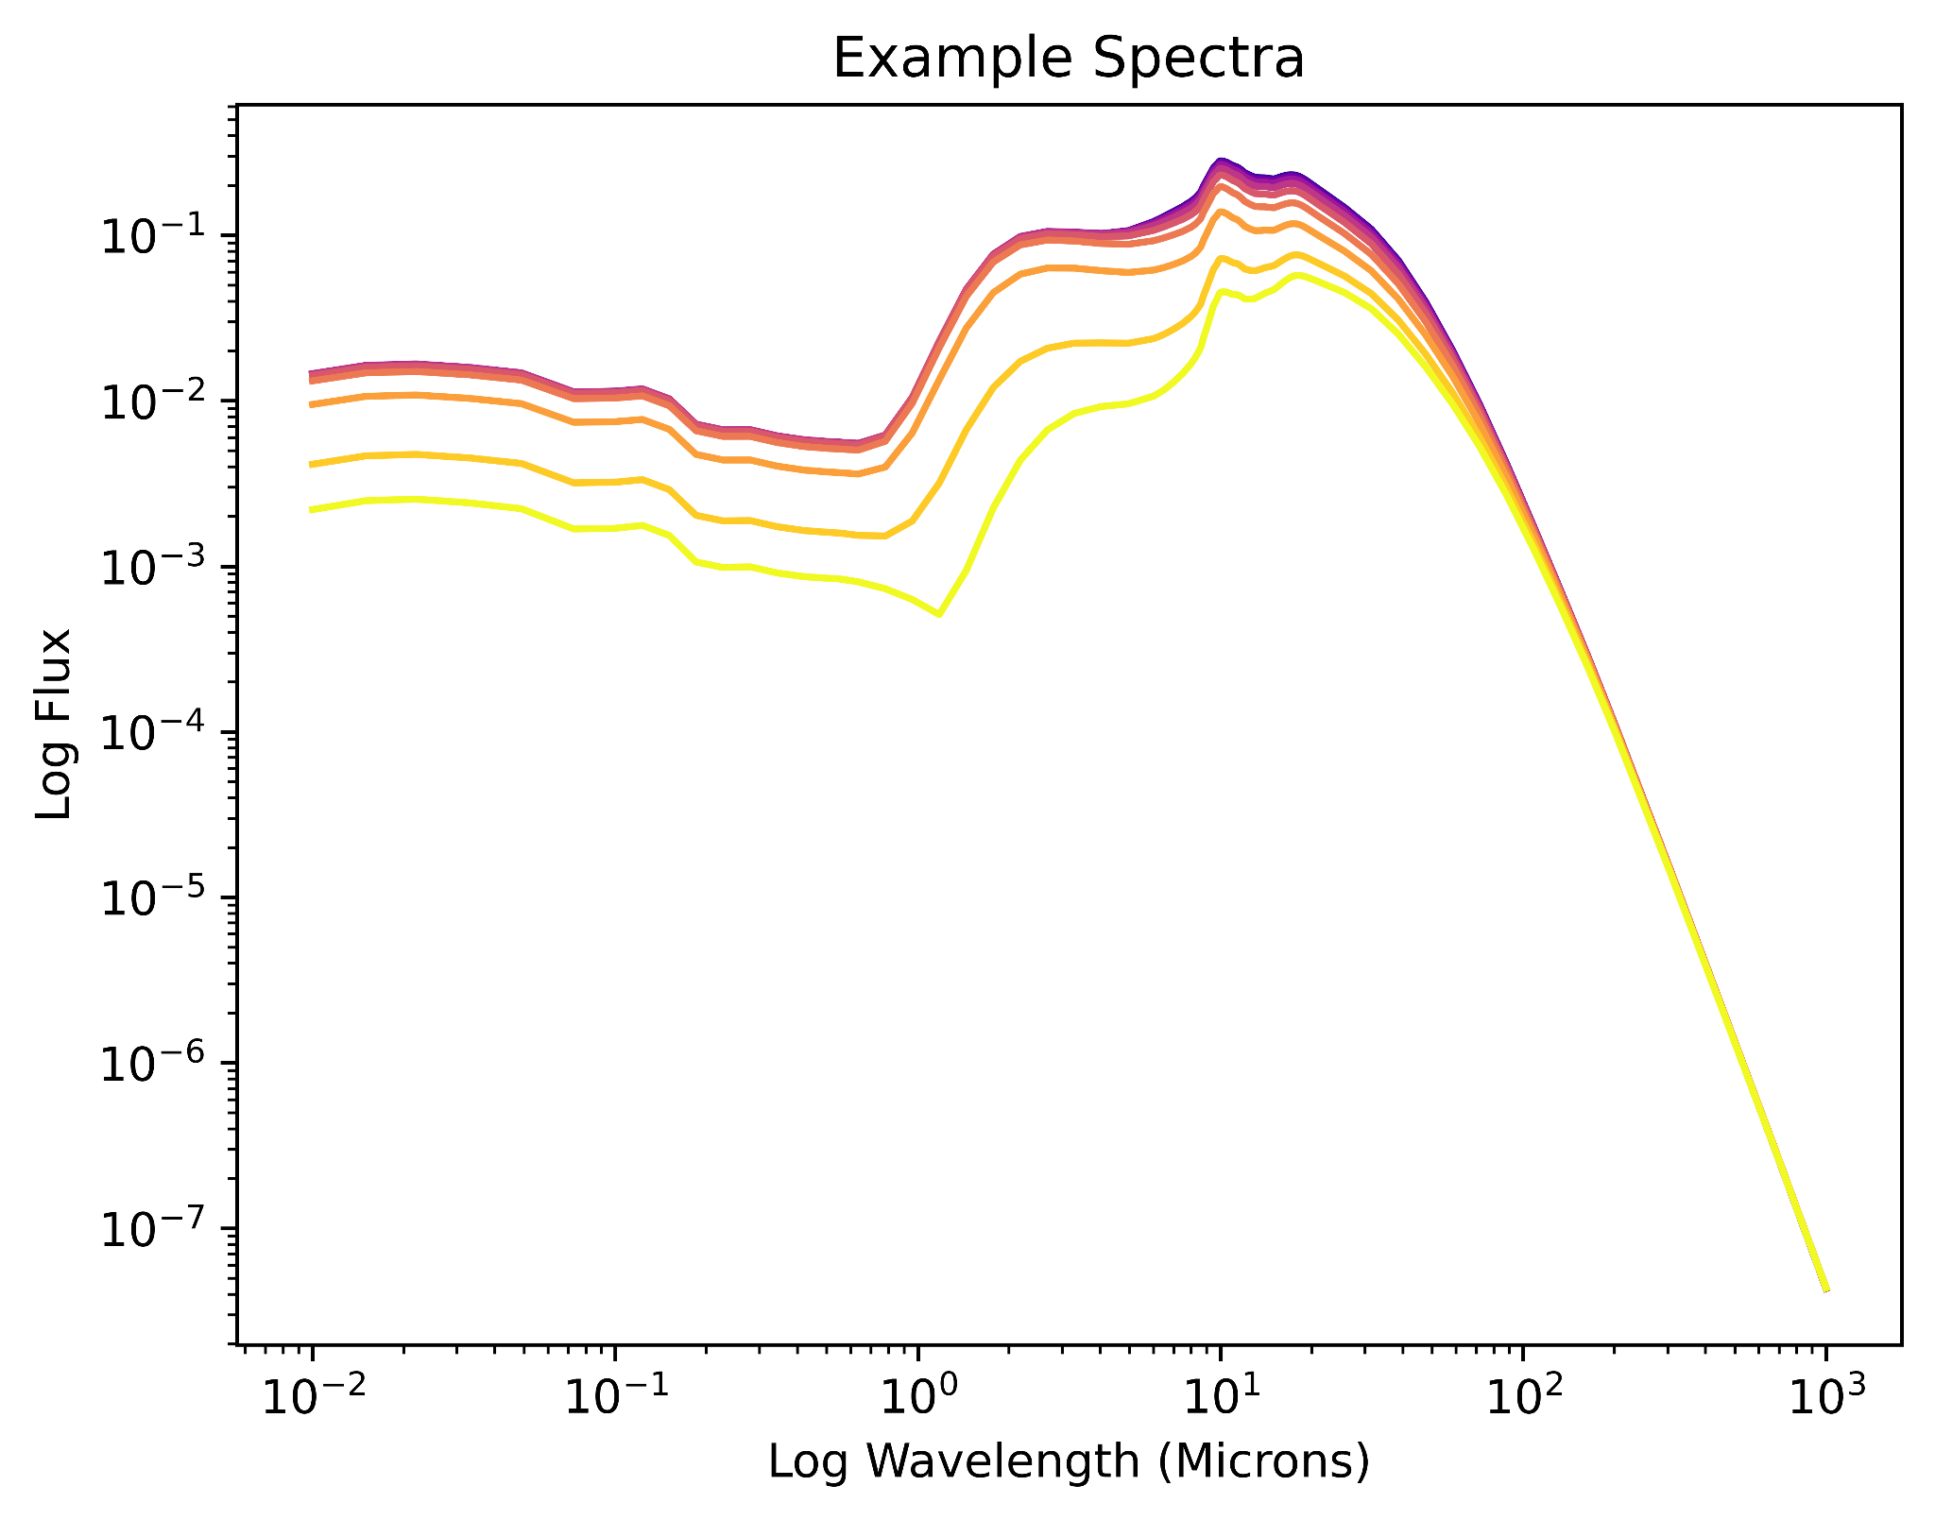
CLUMPY model explains these features
Six parameters as input
τ_{V} - single cloud optical depth
N₀ - clouds in equatorial plane
σ - angular torus width
Y = R_{o}/R_{d} - torus thickness
r^{-q} - radial cloud distribution
i - observer viewing angle
Outputs SED

Slide 9
Models are slow to build and expensive to store
Existing set of ~1.2 million models
Covers wide parameter space
~1.2 GB of disk usage
0.5 GB for storing SED only
Cumbersome to interpolate
From: www.clumpy.org, precomputed due to slow build (radiative transfer)
Goals for new set
Same parameter space coverage
Smaller storage footprint
Fast to load and generate new models within parameter space
Accurate as possible to original CLUMPY models with same input parameters

Slide 10

Two methods: PCA and Machine Learning
Principal Component Analysis
Reduce dimensionality of models and find rotation of coordinate system such that projection onto new set of axes minimizes total variance; first PCA explains most variance, etc.
Can recreate original CLUMPY SEDs with just a few PCAs (and with a small loss of accuracy)
Simple to implement with SciPy
Machine Learning - Autoencoder
Create a neural network of weights - decoder half of autoencoder
Train it on the original CLUMPY model set
Full set of models reduced to a small set of weights
Load ML model and input any parameters to reproduce an SED with some error
Simple to implement with Tensorflow and Keras
Notes:
Both are dimensionality reduction -> both reduce data to representation we can’t see suitable rotation of axes so that the points are the least variance - only one PCA reduction - > Each component explains less and less of the variance

Slide 11
First Method: decompose original models with PCA
Decompose originals into weights and components
Multiply matrices to recompose original dataset
Interpolate over the 6-dimensional parameter space to generate new SED
Weights (1.2 million x 7)
CLUMPY Model Set
(1.2 million x 119)
Interpolated SED
PCA
Recompose
Components (7 x 119)
Notes:
Talk about numbers in the squares

Slide 12
Second Method: uncover latent model from machine learning
Train with CLUMPY models to cover full parameters space
Then generate random parameters and get an SED out
Training Data Parameters
Neural Network of Weights
Evaluate with training data SED
Random Model Parameters
Trained Neural Network
SED

Slide 13
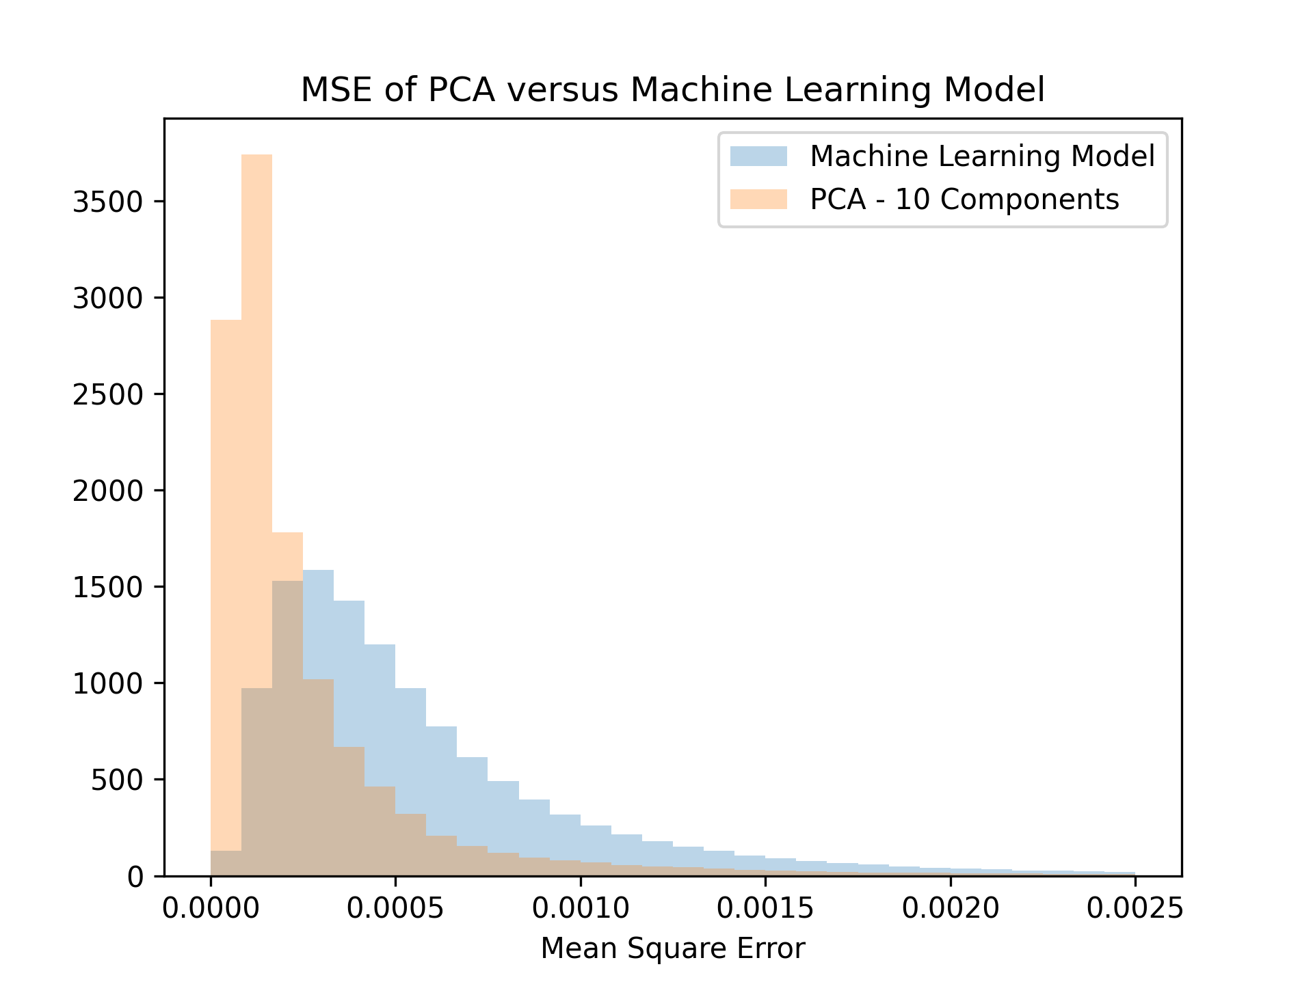
ML is faster, smaller, and more accurate than PCA
Faster to reconstruct, slower to train
No need to set up n-D interpolation
No need to reload full set of models from decomposed file
Can generate 1 million SED in ~16 seconds
Lightweight disk size
ML: 340 KB, ~1275x compression
PCA: 49 MB, ~9x compression
Slightly lower accuracy
At higher number of components but a smaller file and faster reconstruction (trade-offs to make)

Slide 14
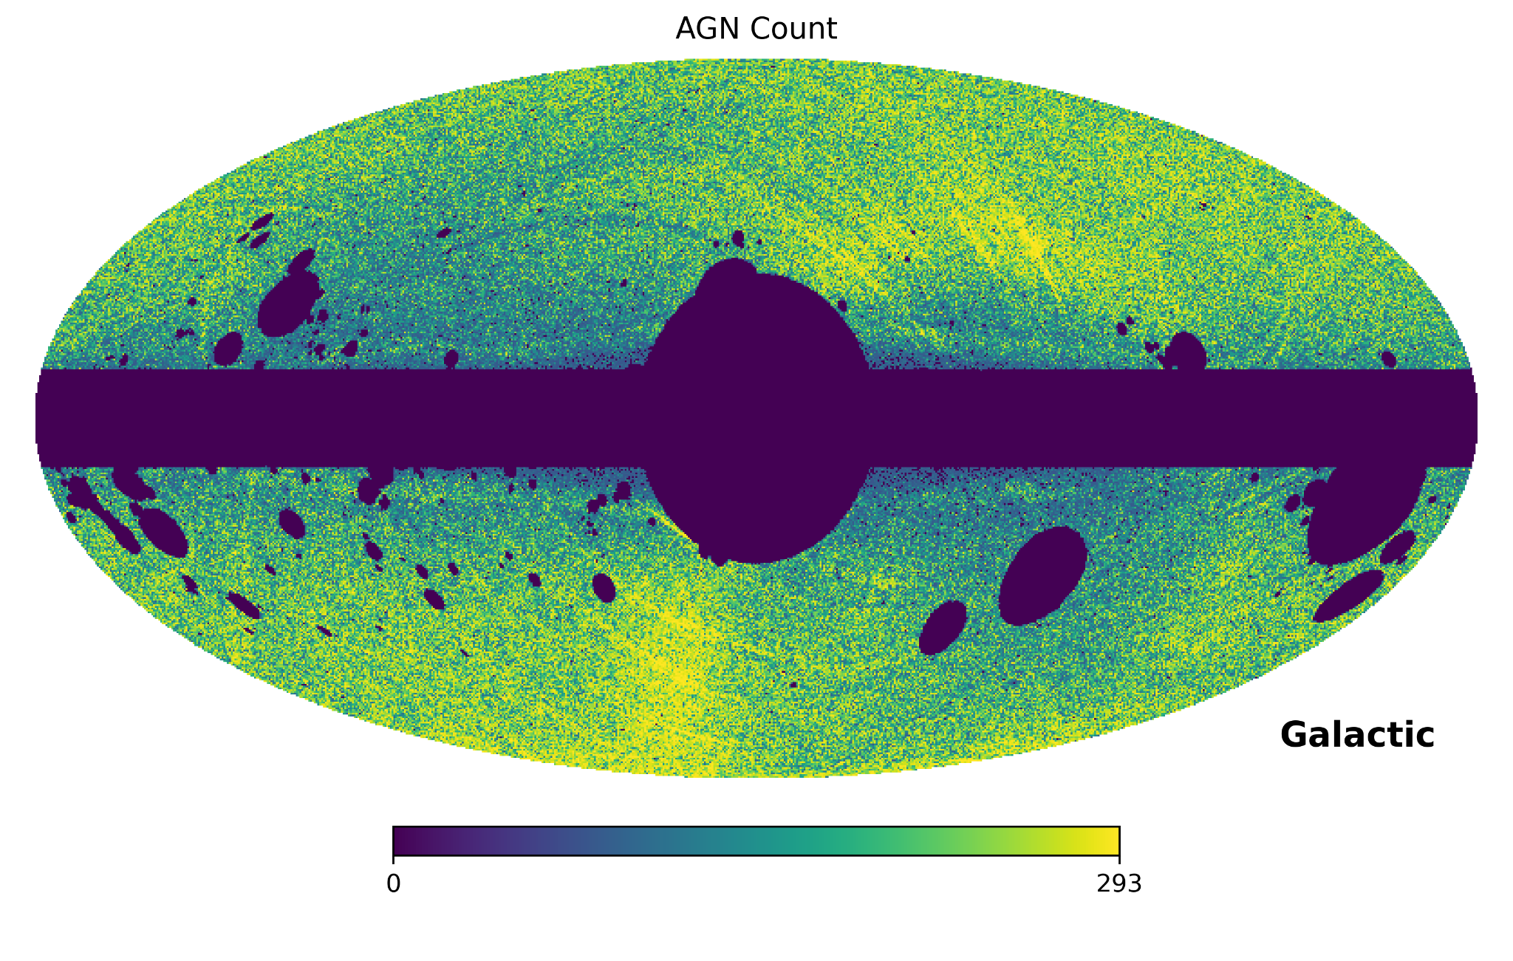
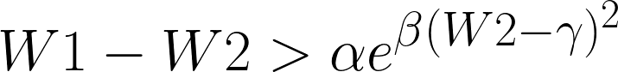
Select clean AGN sample from WISE catalog
Cut out galactic plane and galactic center
Interfering objects
Nearby galaxies
Nebulae
Bright stars
Cut in WISE colors
All selection criteria from Assef et. al. 2018
Notes:
Models based on intuition, just chosen parameter ranges -> compare to real data, find good parameters

Slide 15
Confirmed AGN by crossmatch with SDSS and DESI EDR
Crossmatched our data with SDSS and DESI EDR spectra
Used Data Lab crossmatch tool and 1.5 arcsecond radius
Took only objects classified in AGN categories e.g. QSO
Require accurate redshift for future reddening in spectra of models
cut objects with high redshift error and high/low redshift
Final catalog is ~250,000 objects

Slide 16
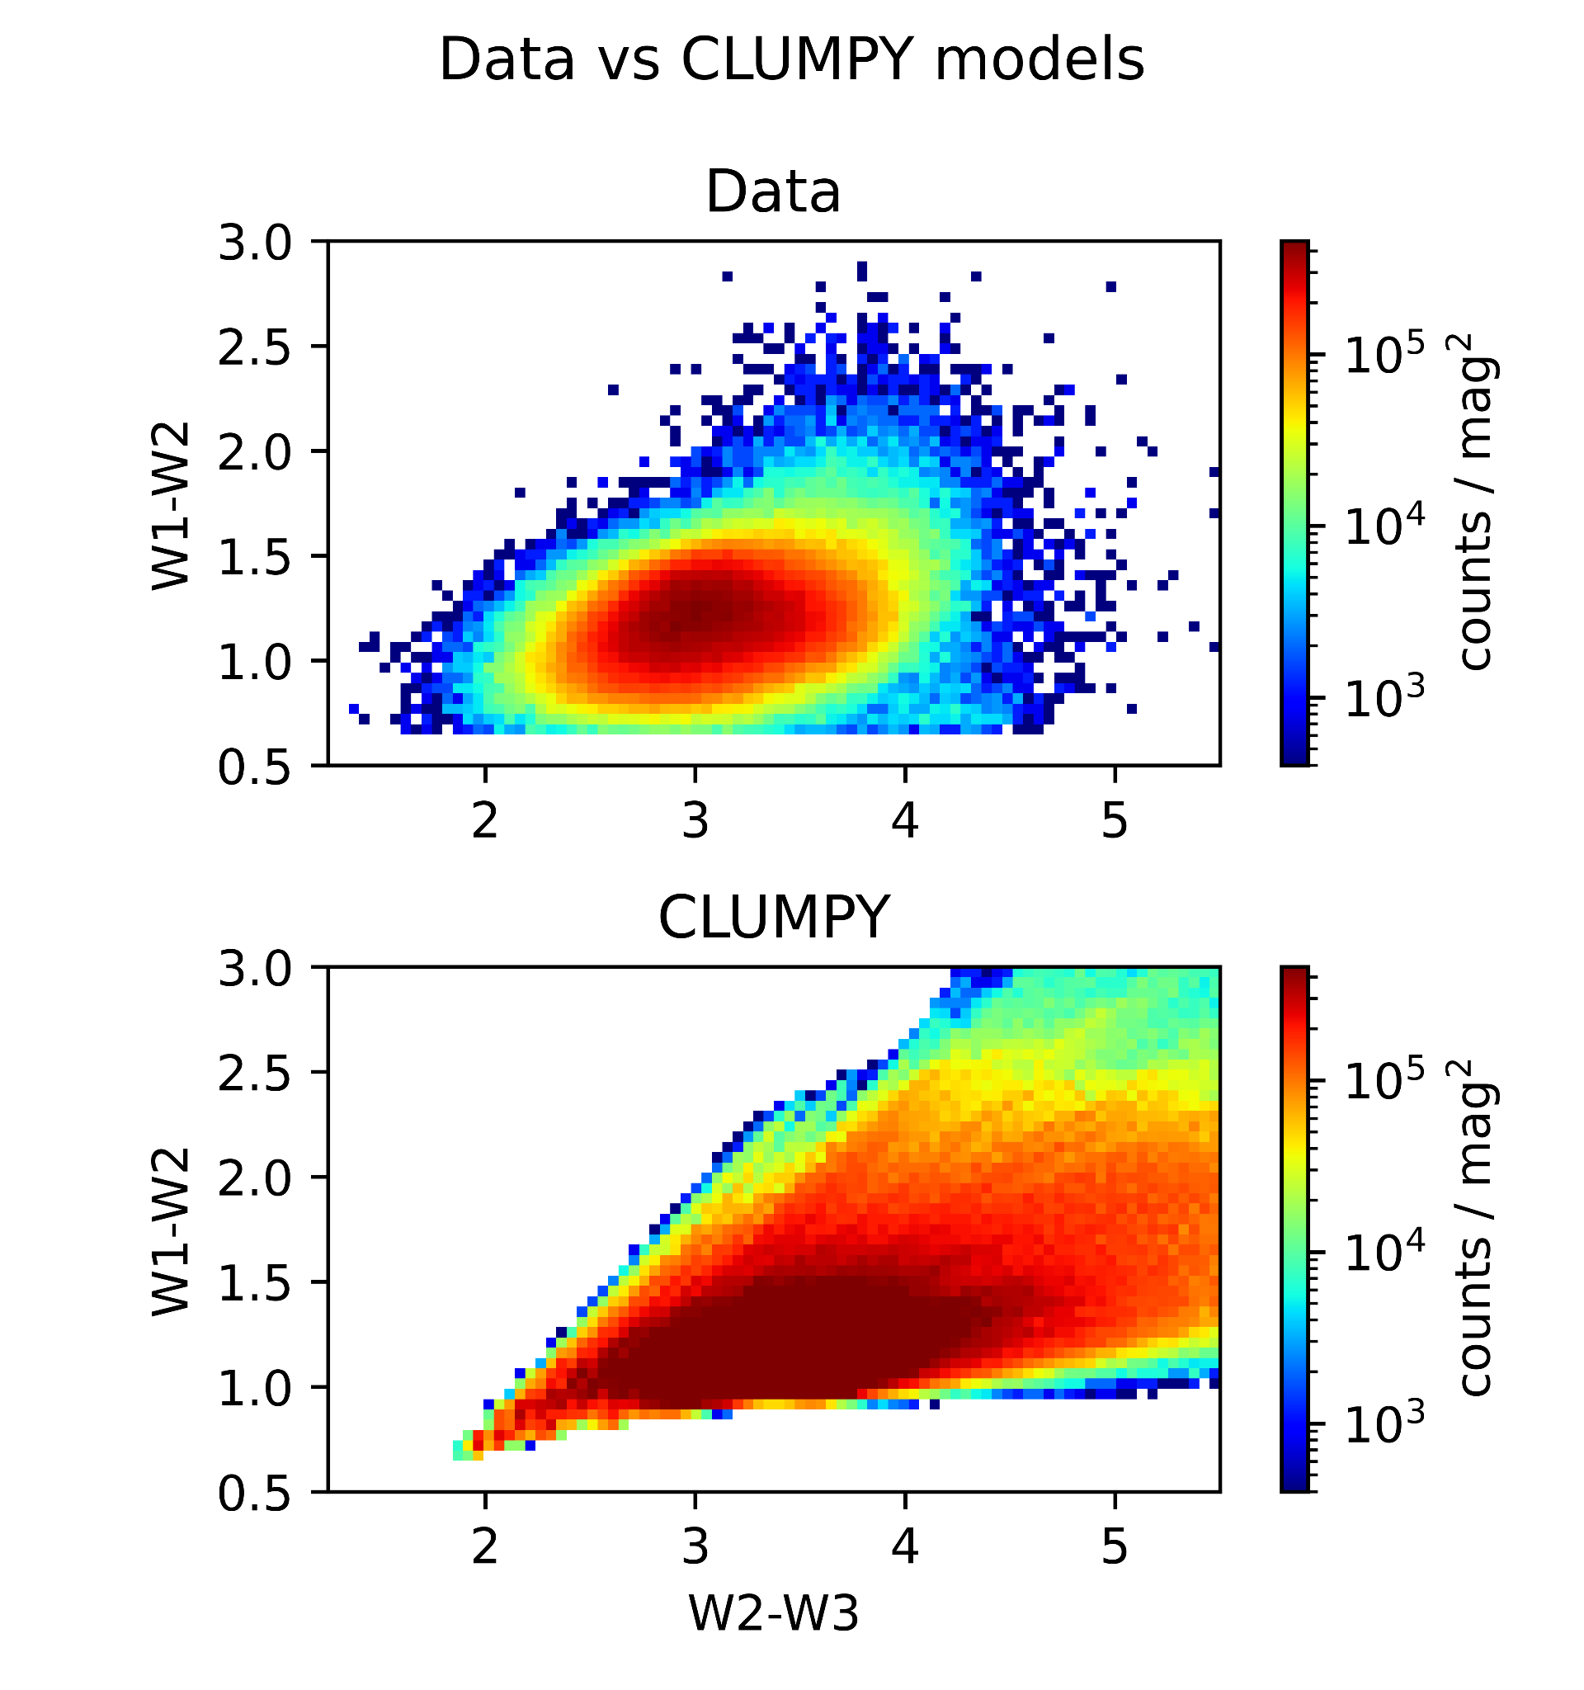
Find model weights with regression
Sampling of model parameters uniform. True distribution in nature is unknown.
Goal: find distribution of model parameters consistent with observations.
Generate many model color tracks (here 1M)
Compute colors as function of viewing angle
Requires 100 million SED - 100 viewing angles/model
Perform regression on color tracks: find weights for each model such that the linear combination explains the color-color distribution of WISE AGN

Slide 17
Regression and regularization
Need to find a combination of models to recreate observed data (CC histogram)
Regression finds weights for each model such that the linear combination minimizes the residuals
Regularization of weights
Regularization penalizes too large individual weights
Is also used to enforce non-negative weights, since a model can not contribute negatively (unphysical)
L1 regularization (Lasso) - adds the sum of the absolute value of parameters to MSE
L2 regularization (Ridge) - adds the sum of the square of parameters to MSE
Both penalize outliers by encouraging smaller parameter values and reduce variance
Multiplication of L1 and L2 by constant value α modifies this penalization
α < 1 - less penalization than baseline
α > 1 - more penalization than baseline

Slide 18
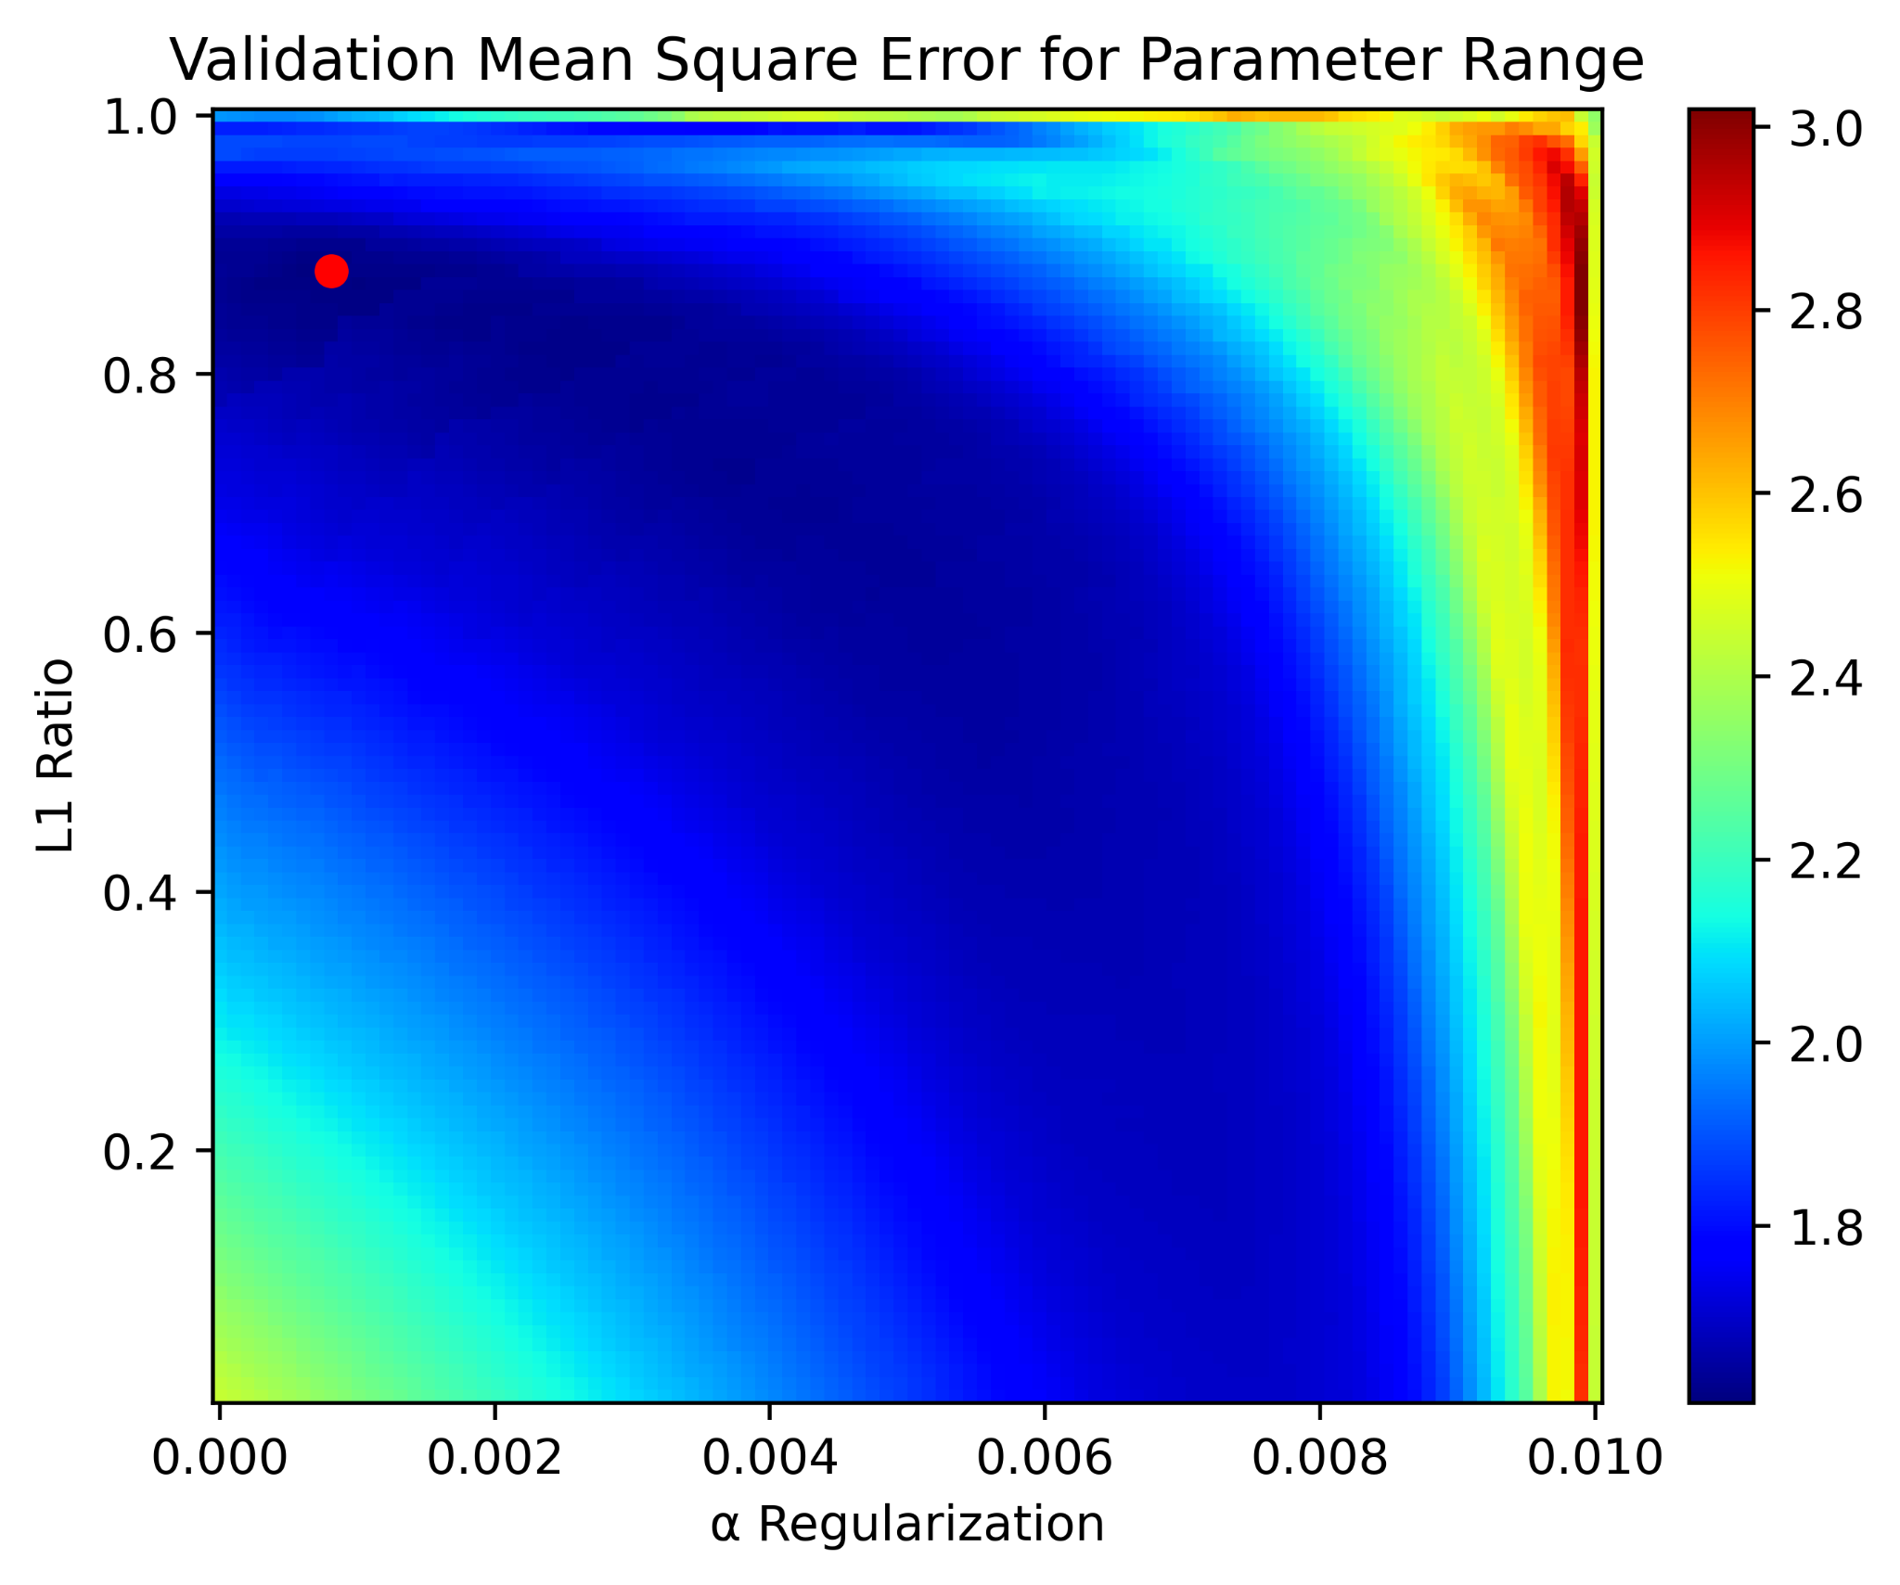
Cross Validation of Regularization and Normalization Ratio
ElasticNet uses a combination of the L1 and L2 normalizations
Cross validating by running a matrix of α and L1 ratio
Ran on ~1 million random SED
Found best α and L1 ratio for our case empirically
L1 ratio is the percent of L1 normalization
L1 ratio of 1 is 100% L1 normalization
L1 ratio of 0 is 100% L2 normalization

Slide 19
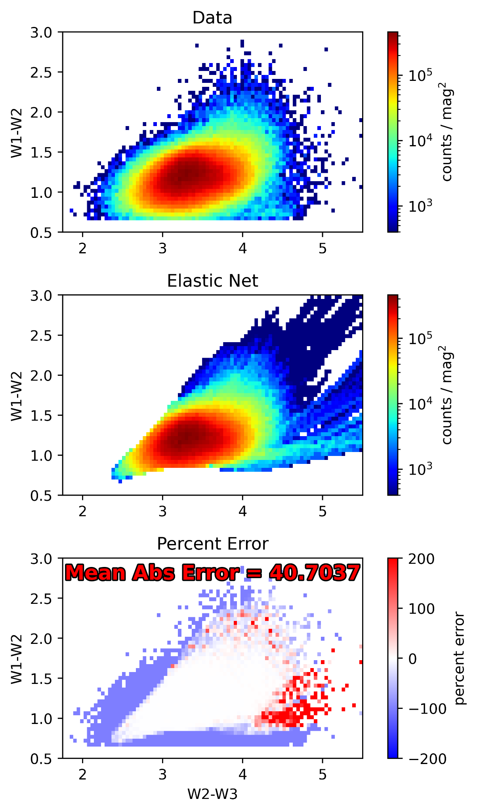
Models reproduce observed AGN counts
The Elastic Net produces a close approximation of the data
Residuals next to none in areas where models cover
Models are not yet reddened → need to account for drop-outs
Also, models have a known deficiency in 1-2 micron flux, making them a bit too red → next steps

Slide 20
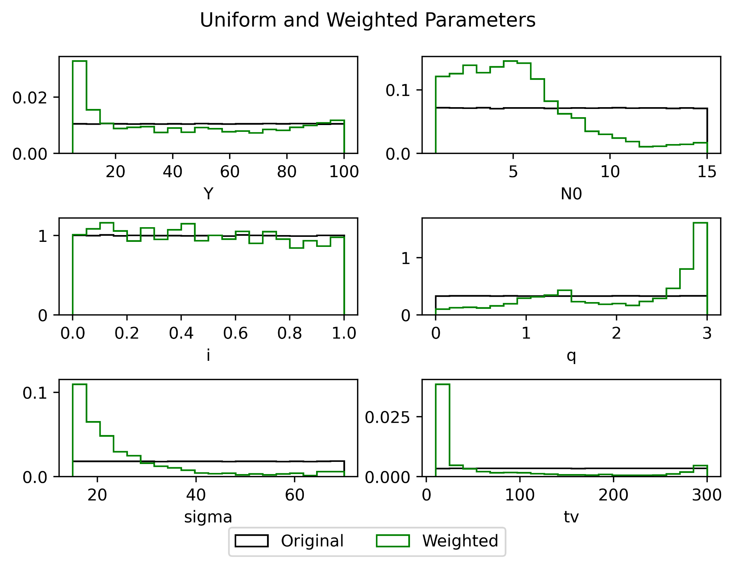
Parameter Distribution
Regression weights change distribution of parameters from uniform input sampling
Can determine what parameter range of CLUMPY models is more physical for real AGN
Initial results suggest: small torus size Y, small to intermediate number of clouds N0, steep radial distribution of clouds, torus width consistent with type1/2 number statistics, relatively small cloud optical depth.

Slide 21
Questions?

Slide 22

EXTRA SLIDES FOR REFERENCE

Slide 23
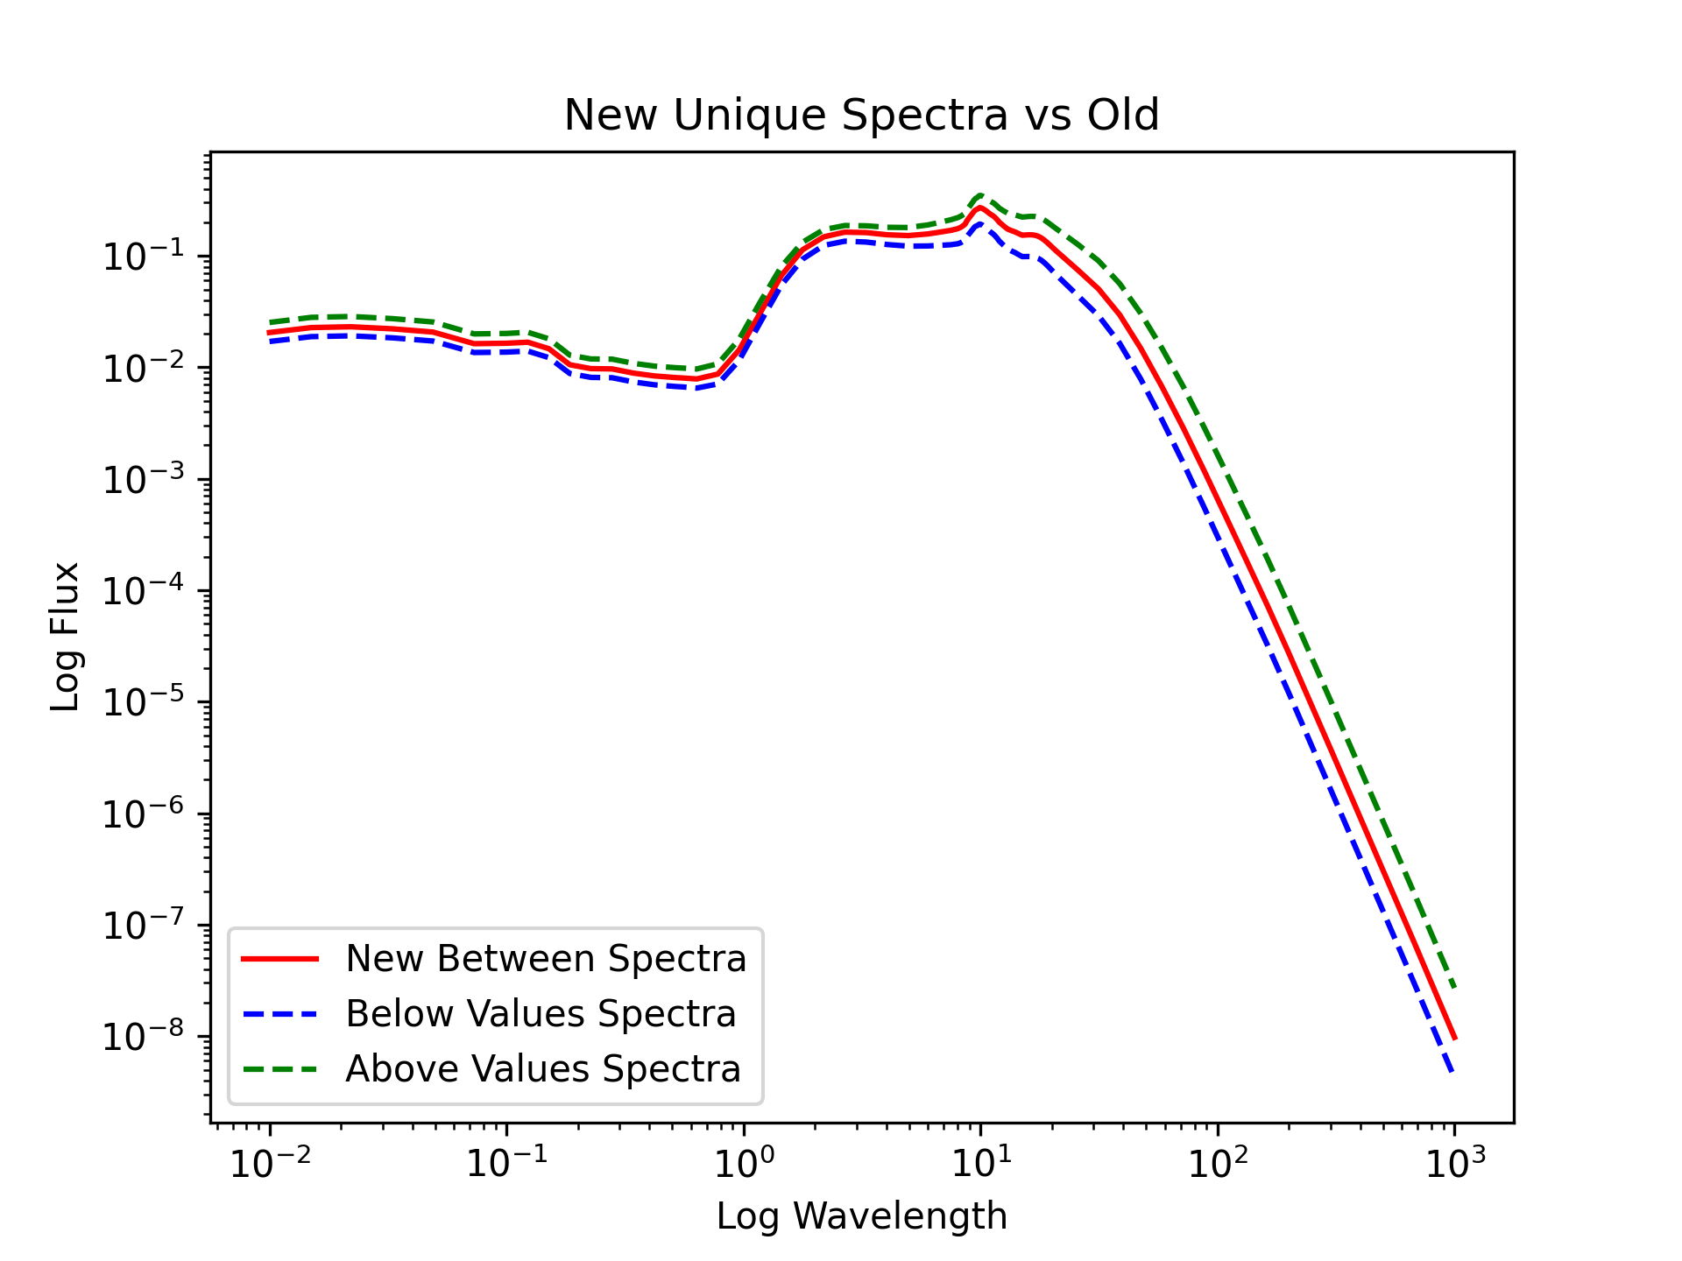

Slide 24
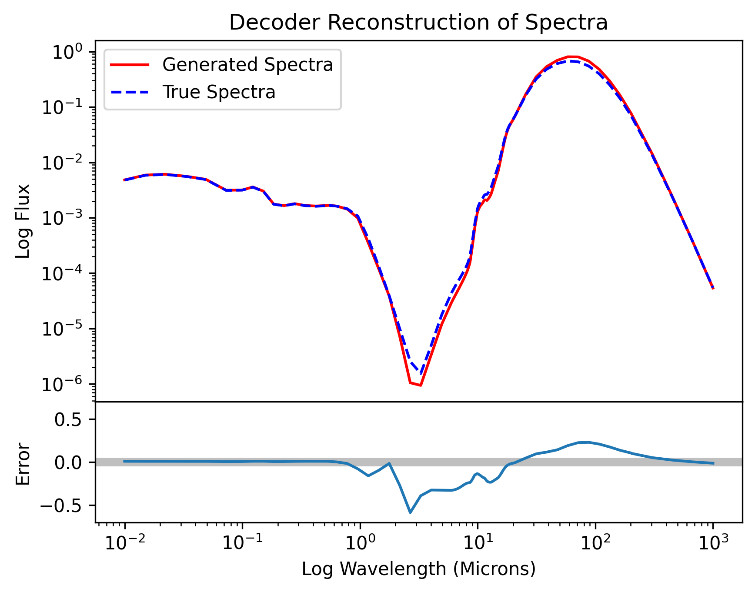

Slide 25
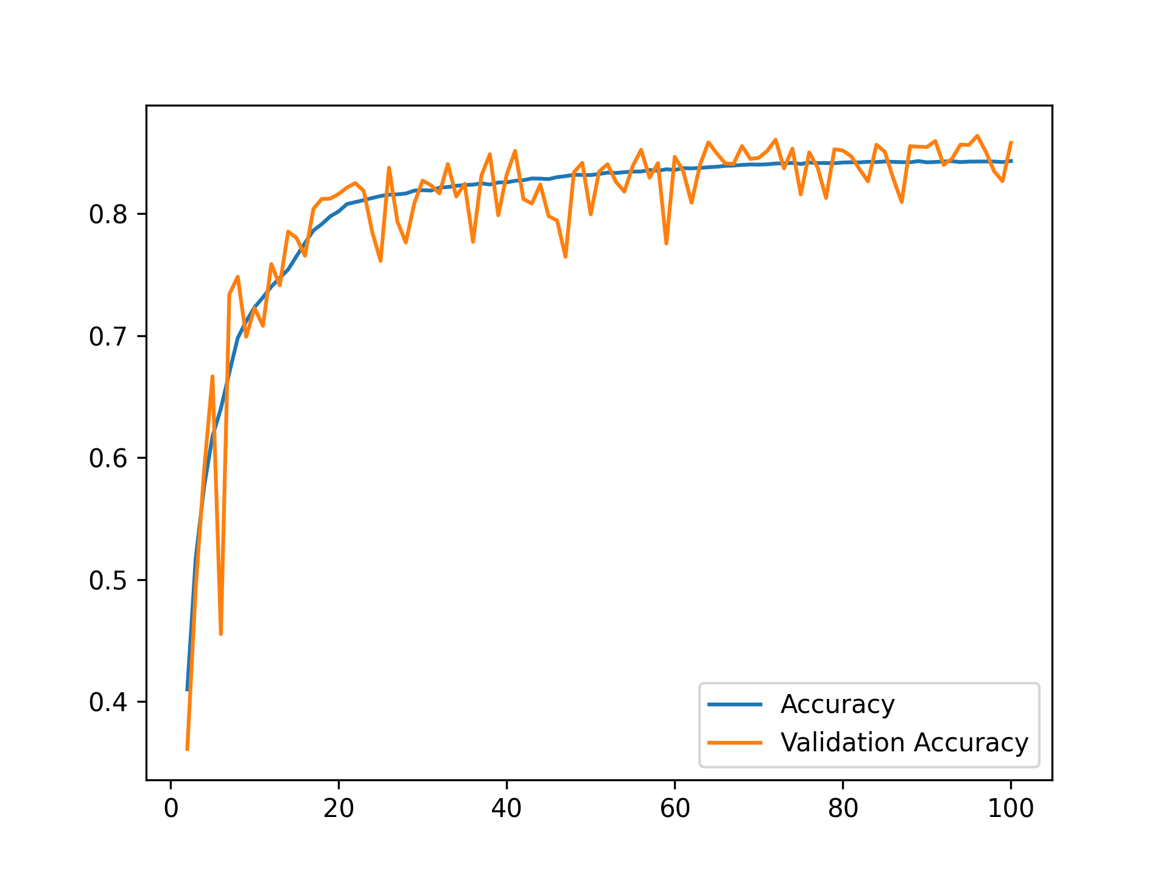
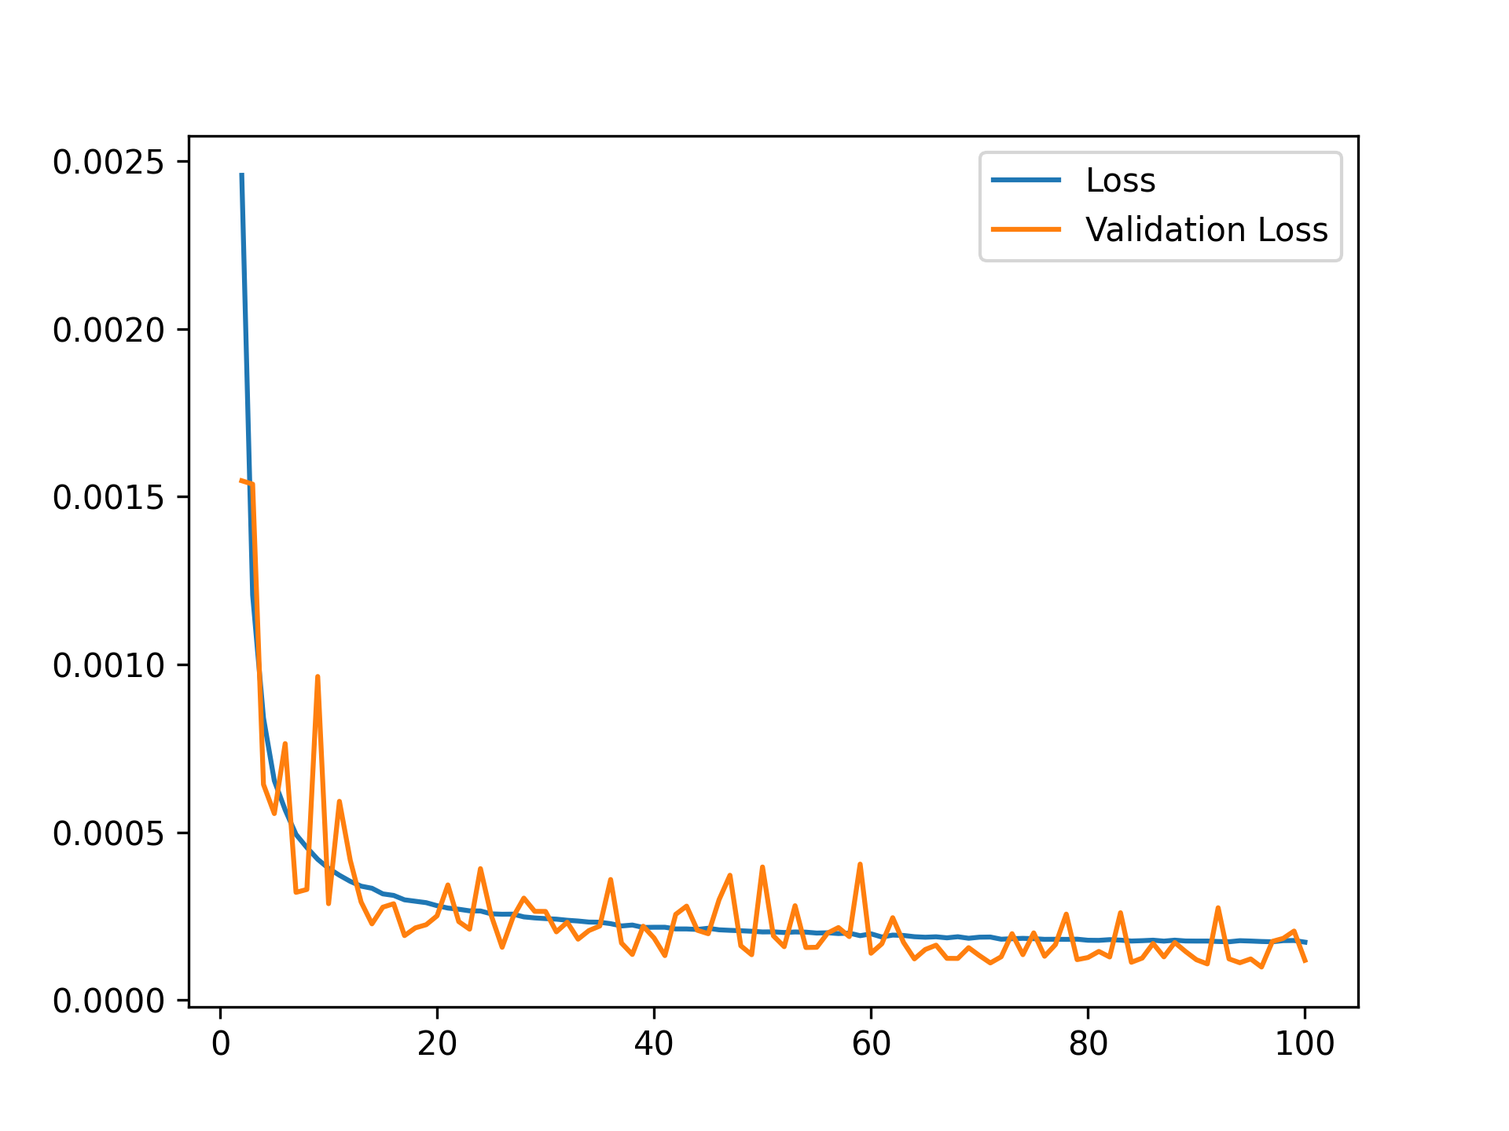

Slide 26
